Slide 1

Artificial neural networks
Cherrie liang

Slide 2
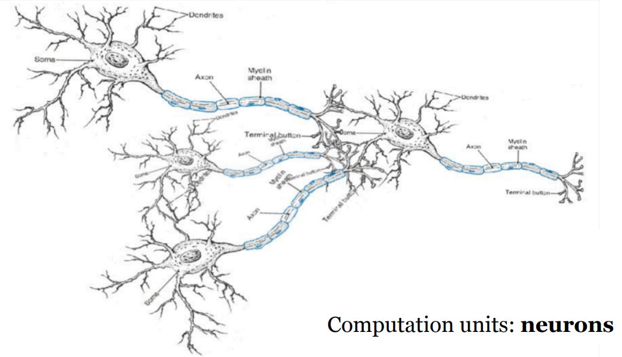
What is Artificial Neural Networks?
The human brain processing consist of neurons that form a network.

Slide 3
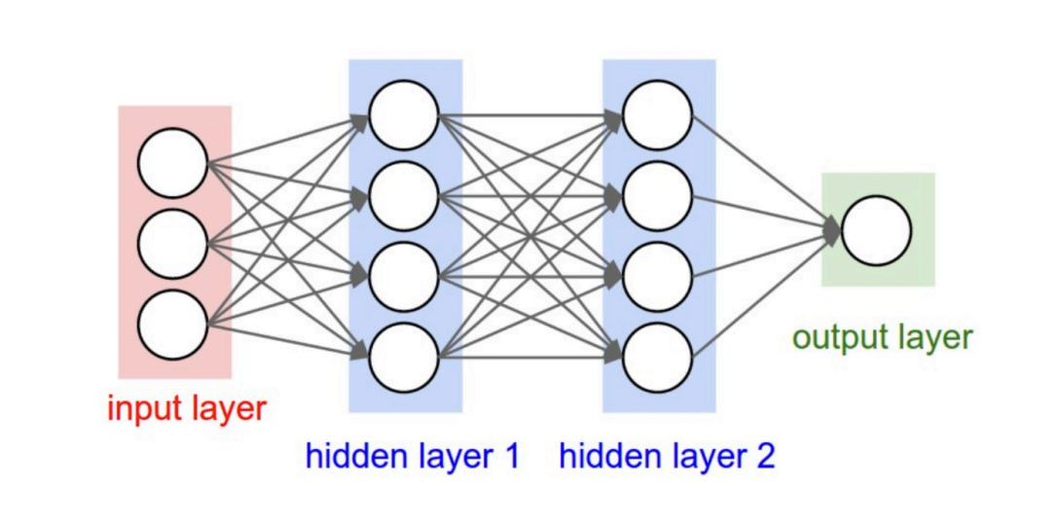
What is Artificial Neural Networks?
It is a deep learning algorithm that imitates the structure of human brain.

Slide 4
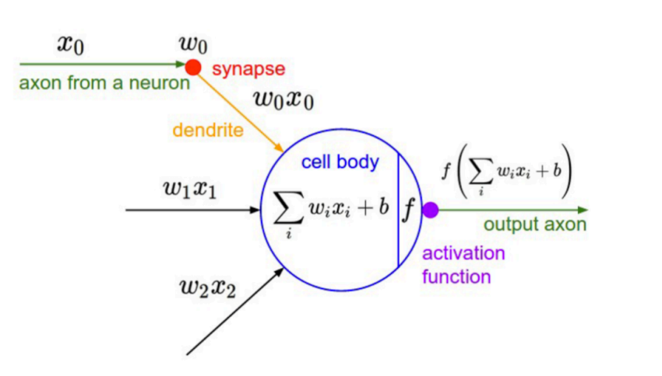
What is an Artificial Neuron?
Artificial Neurons are basic formations of the NN model
A neuron is a computational unit that has scalar inputs and an output
Each input has an associated weight.
The neuron multiples each input by its weight, sums them, applied a nonlinear function (called activation function) to the result, and passes it to its output.

Slide 5
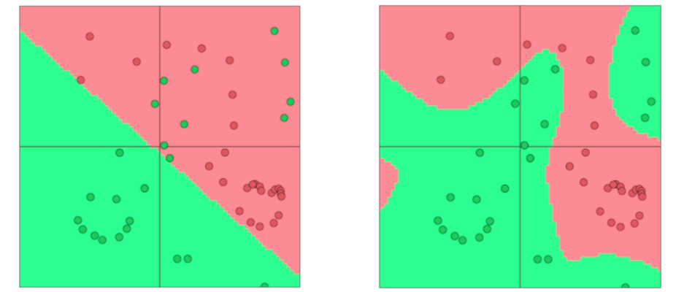
Why Activation Functions?
Neural networks can learn much more complex functions and nonlinear decision boundaries
The capacity of the network increases with more hidden units and more hidden layers

Slide 6
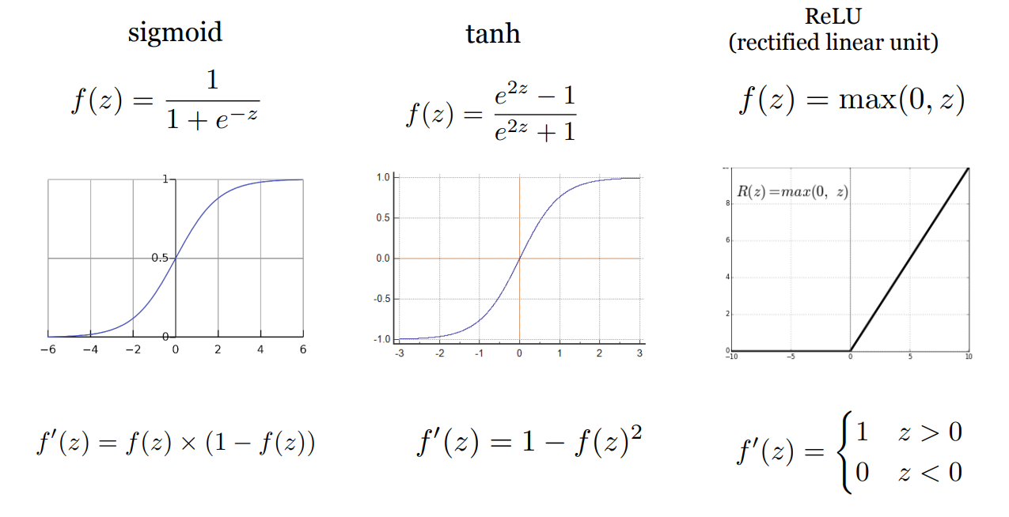
What Activation Functions?
Neural networks can learn much more complex functions and nonlinear decision boundaries

Slide 7
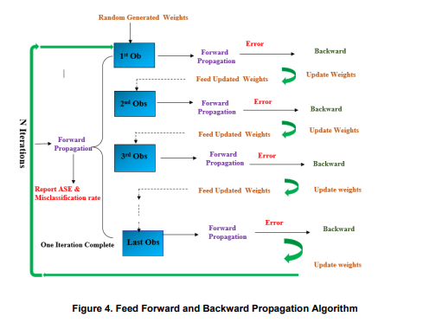
Neural Network algorithm
Forward Propagation and Backward Propagation
Error is calculated based on a chosen Loss Function
Forward Propagation is essentially logistic regression unit with activation.
Backward Propagation updates the weights and feed to the next observation for forward propagation
It is done iteratively to achieve the best weight
Weight update uses the partial differential.

Slide 8

Loss Functions
Calculate the error between actual vs predicted to determine accuracy
Binary classification
$$y=σ(w^{(o)}∙h_{1}+b^{(o)})$$
$$ℒ\left(y,y^{∗}\right)=−y∗logy−\left(1−y\right)∗log(1−y)$$
Regression
$$y=w^{(o)}∙h_{1}+b^{(o)}$$
$$ℒ\left(y,y^{∗}\right)={(y−y^{∗}\text{)} }^{2}$$
Multi-class classification (C classes)
$y_{i}={{softmax}_{i} (w}^{(o)}∙h_{1}+b^{(o)}$) $w^{(o)}∈ℝ^{C×d}$
$$ℒ\left(y,y^{∗}\right)=−\sum_{i=1}^{C}{y_{i}^{∗}log⁡(y_{i})}$$
The question becomes how to compute: $∇_{θ}ℒ\left(θ\right)$
$$θ=\{W^{(1)},b^{(1)},w^{(o)},b^{(o)}\}$$
Ɵ represents all the parameters (weights and biases)

Slide 9

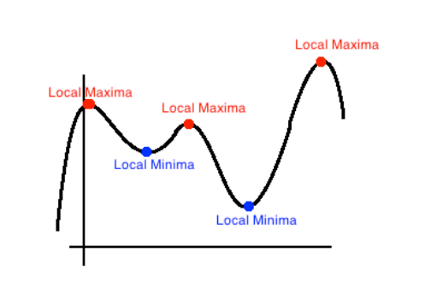
Backward Propagation
Update weights using partial differentials
Basically, it comes down to adjusting weights according to its gradient.
Ƞ represent the learning rate, which is the step length of the weight updating process.
Neural networks are non-convex and not easy to optimize.
A class of more sophisticated “adaptive” optimizers that scale the parameter adjustment by an accumulated gradient.
Adam
Adagrad
RMSprop

Slide 10
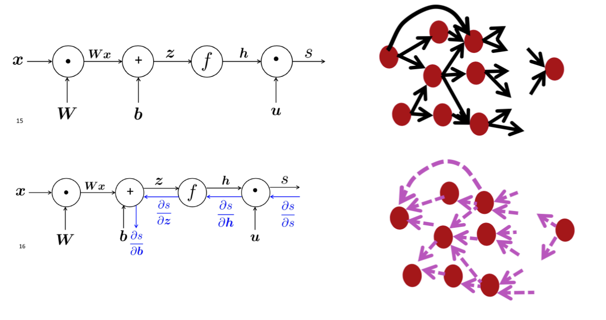
Computational Graphs – Forward and Backward Propagation

Slide 11
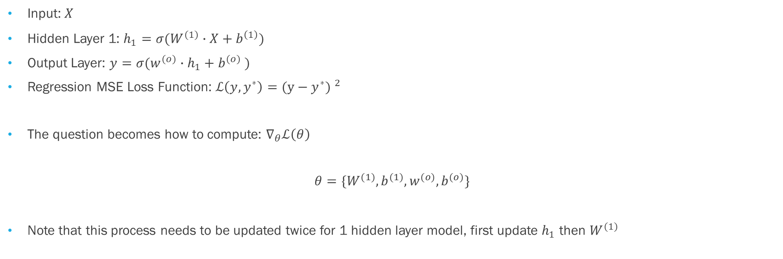
Backward Propagation
Deriving gradients - Example
Input: $X$
Hidden Layer 1: ${h_{1}=σ(W}^{(1)}∙X+b^{\left(1\right)})$
Output Layer: $y={σ(w}^{(o)}∙h_{1}+b^{(o)}$ $)$
Regression MSE Loss Function: $ℒ\left(y,y^{∗}\right)={(y−y^{∗}\text{)} }^{2}$
The question becomes how to compute: $∇_{θ}ℒ\left(θ\right)$
$$θ=\{W^{(1)},b^{(1)},w^{(o)},b^{(o)}\}$$
Note that this process needs to be updated twice for 1 hidden layer model, first update $h_{1}$ then $W^{(1)}$
$∇_{w^{(o)}}ℒ\left(w^{(o)}\right)=\frac{∂L}{∂y}∗\frac{∂y}{∂σ}$ $∗$ $\frac{∂σ}{∂W }$ = $(y−y^{∗}\text{)}∗y^{∗}(1−y^{∗})∗h_{1}$
$∇_{W^{(1)}}ℒ\left(W^{(1)}\right)=\frac{∂y}{∂σ}$ $∗$ $\frac{∂σ}{∂W}$ =${ h}_{1}(1−h_{1})∗X_{1}$

